Slide 1
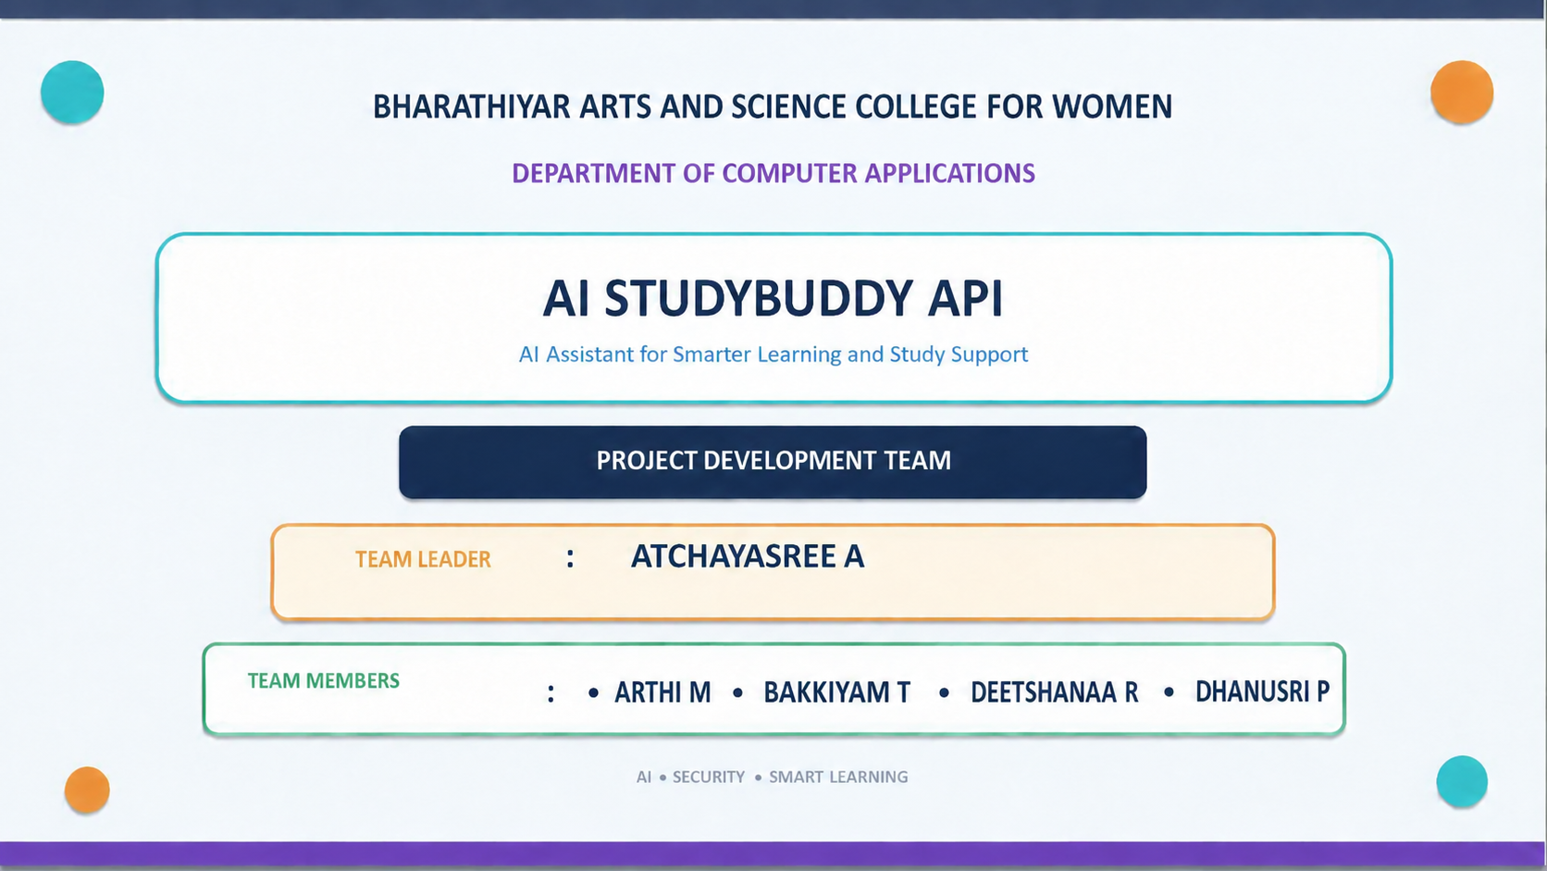
BHARATHIYAR ARTS AND SCIENCE COLLEGE FOR WOMEN
DEPARTMENT OF COMPUTER SCIENCE WITH CYBER SECURITY
AI STUDYBUDDY API
AI Assistant for Smarter Learning and Study Support
PROJECT DEVELOPMENT TEAM
PROJECT DEVELOPMENT TEAM
TEAM LEADER
: ATCHAYASREE A
TEAM MEMBERS
: • ARTHI M • BAKKIYAM T
AI • SECURITY • SMART LEARNING
1

Slide 2
1. Introduction & Problem Statement
Why AI StudyBuddy is needed
• AI-powered learning platform designed to simplify the study process.
• Students can upload study materials and generate summaries, flashcards, quizzes and personalized study plans.
• Traditional preparation is repetitive and time-consuming, especially when materials are scattered across multiple sources.
• Centralized learning resources reduce switching between separate applications and support faster revision.
SCATTERED MATERIALS
MANUAL NOTES
NO PERSONALIZED PLAN
DIFFICULT SELF-TESTING
AI STUDYBUDDY
2

Slide 3
2. System Architecture
Modular RESTful backend with AI integration
AI Service
Google Gemini
React.js
Client Application
Express.js
REST API
JWT Auth
Middleware
Controller /
Business Logic
MongoDB +
Mongoose
• Separation of authentication, business logic, AI services and database operations improves maintainability.
• JWT protects private routes; MongoDB stores users, materials and generated resources.
• Gemini API dynamically generates educational content from user-provided study material.
3

Slide 4
3. User Flow & AI Learning Pipeline
From study material to personalized learning resources
1. Register /
Login
2. JWT
Authentication
3. Upload
Material
4. Select AI
Feature
5. Gemini AI
Processing
6. Save &
Review
SUMMARY
FLASHCARDS
QUIZ
STUDY PLAN
• Generated resources are displayed to the student and can be stored for future reference.
4

Slide 5
4. Technical Architecture & MVC
How the backend is organized
MODEL LAYER
CONTROLLER LAYER
VIEW / API RESPONSE
• Mongoose schemas
• MongoDB collections
• Data validation
• Database interactions
• Request processing
• Input validation
• Authorization
• Calls AI service
• Returns API response
• REST API endpoints
• Structured JSON
• React frontend communication
Routes → Middleware → Controllers → Models / AI Service → JSON Response
5

Slide 6
5. Database, Security & API Layer
Core technical components
MONGODB + MONGOOSE
SECURITY
REST API ENDPOINTS
• Users
• Study Materials
• Summaries
• Flashcards
• Quizzes
• Study Plans
• JWT authentication
• RBAC for Student/Admin
• bcrypt password protection
• Protected API routes
• POST /api/auth/register
• POST /api/auth/login
• POST /api/material/upload
• POST /api/ai/flashcards
• POST /api/ai/quiz
• POST /api/ai/study-plan
6

Slide 7
6. Key Features, Outcome & Future Scope
Impact of the AI-powered backend
SECURE LOGIN
UPLOAD MATERIAL
AI GENERATION
LEARN & REVISE
SAVE RESOURCES
• Automates summaries, flashcards, quizzes and personalized study plans.
• Reduces manual preparation effort and supports faster revision.
• Modular architecture enables future AI-powered learning capabilities with minimal architectural changes.
• Scalable backend combines Node.js, Express.js, MongoDB, JWT/RBAC and Google Gemini AI.
FUTURE SCOPE
• Extend AI learning capabilities
• Add more personalized resources
• Improve scalability and modular services
THANK YOU
7

